Slide 1

“ Tracing Computing's Roots to the Light Bulb "
ASSIGNMENT 03
AHMAD ALI KHAN
ATHAR ABBAS
MOAZ NADEEM
MUKARAM NADEEM
SOFTWARE ENGINEERING(A)
ADAPTED FROM A VIDEO BY VERISTASIUM (YOUTUBE)
Notes:
f

Slide 2





KEY OBJECTIVES OF PRESENTATION
01
Thermionic Emission Discovery The light bulb led to the discovery of thermionic emission, which became the core principle behind vacuum tubes.
Education
02
Development of Vacuum Tubes Vacuum tubes, based on light bulb technology, were used as the first electronic switches and amplifiers in early computers.
Collaboration
Scientific Contributions Inventors like Tesla, Edison, and Boole connected electricity, logic, and switching—forming the base of modern computing systems.
03
Equal contribution

Slide 3
The early light bulbs used vacuum tubes. They used filament that heats up to give light.
THE EARLY LIGHT BULBS
Some of the electrons flow out from the filament and make the tube-colored yellow.

Slide 4
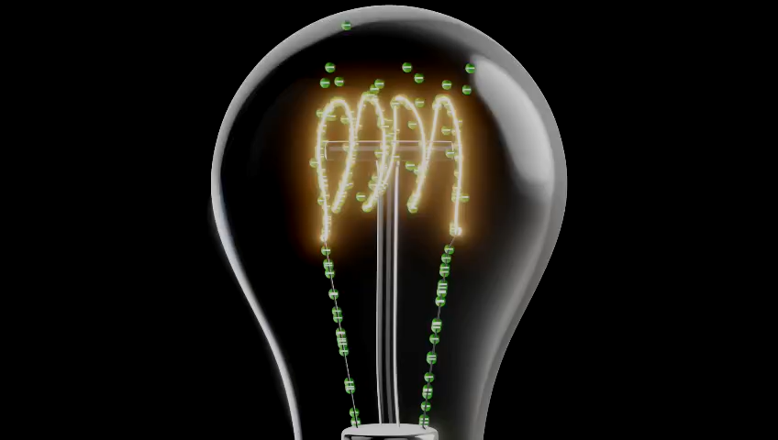

Slide 5
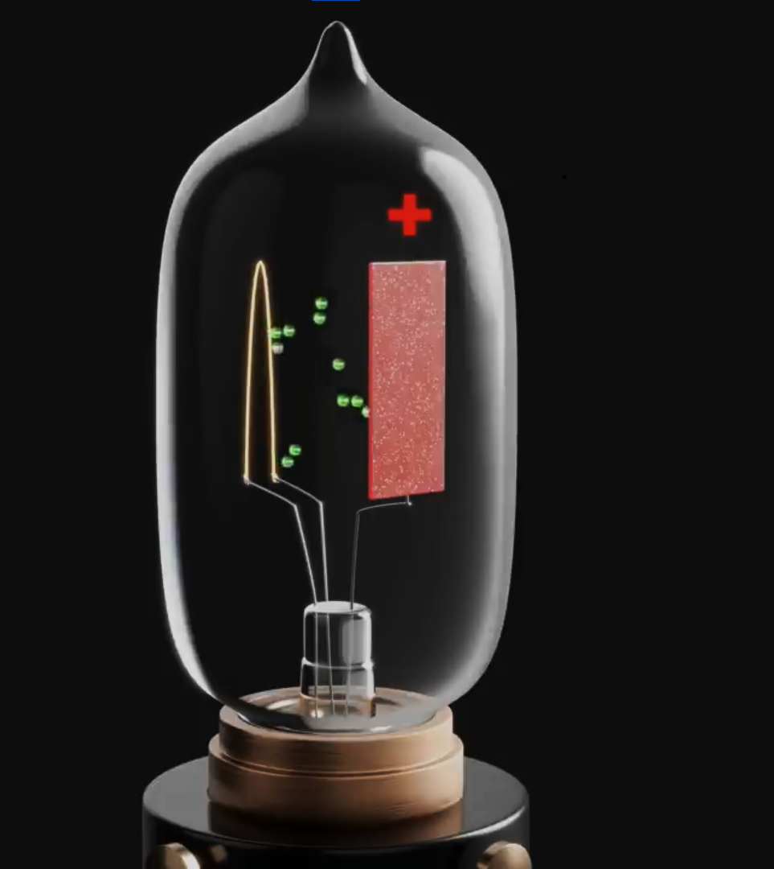
Scientists discovered this phenomena as thermionic emission. They worked on it and made a device … Thermionic Diode.
A simple vacuum tube that consists of two filaments instead of one.
If we charge one filament as positive the current flows from one filament to the other and thus the circuit completes.
But if we charge both of them negative. Then the current will not flow at all. The circuit remains open.

Slide 6
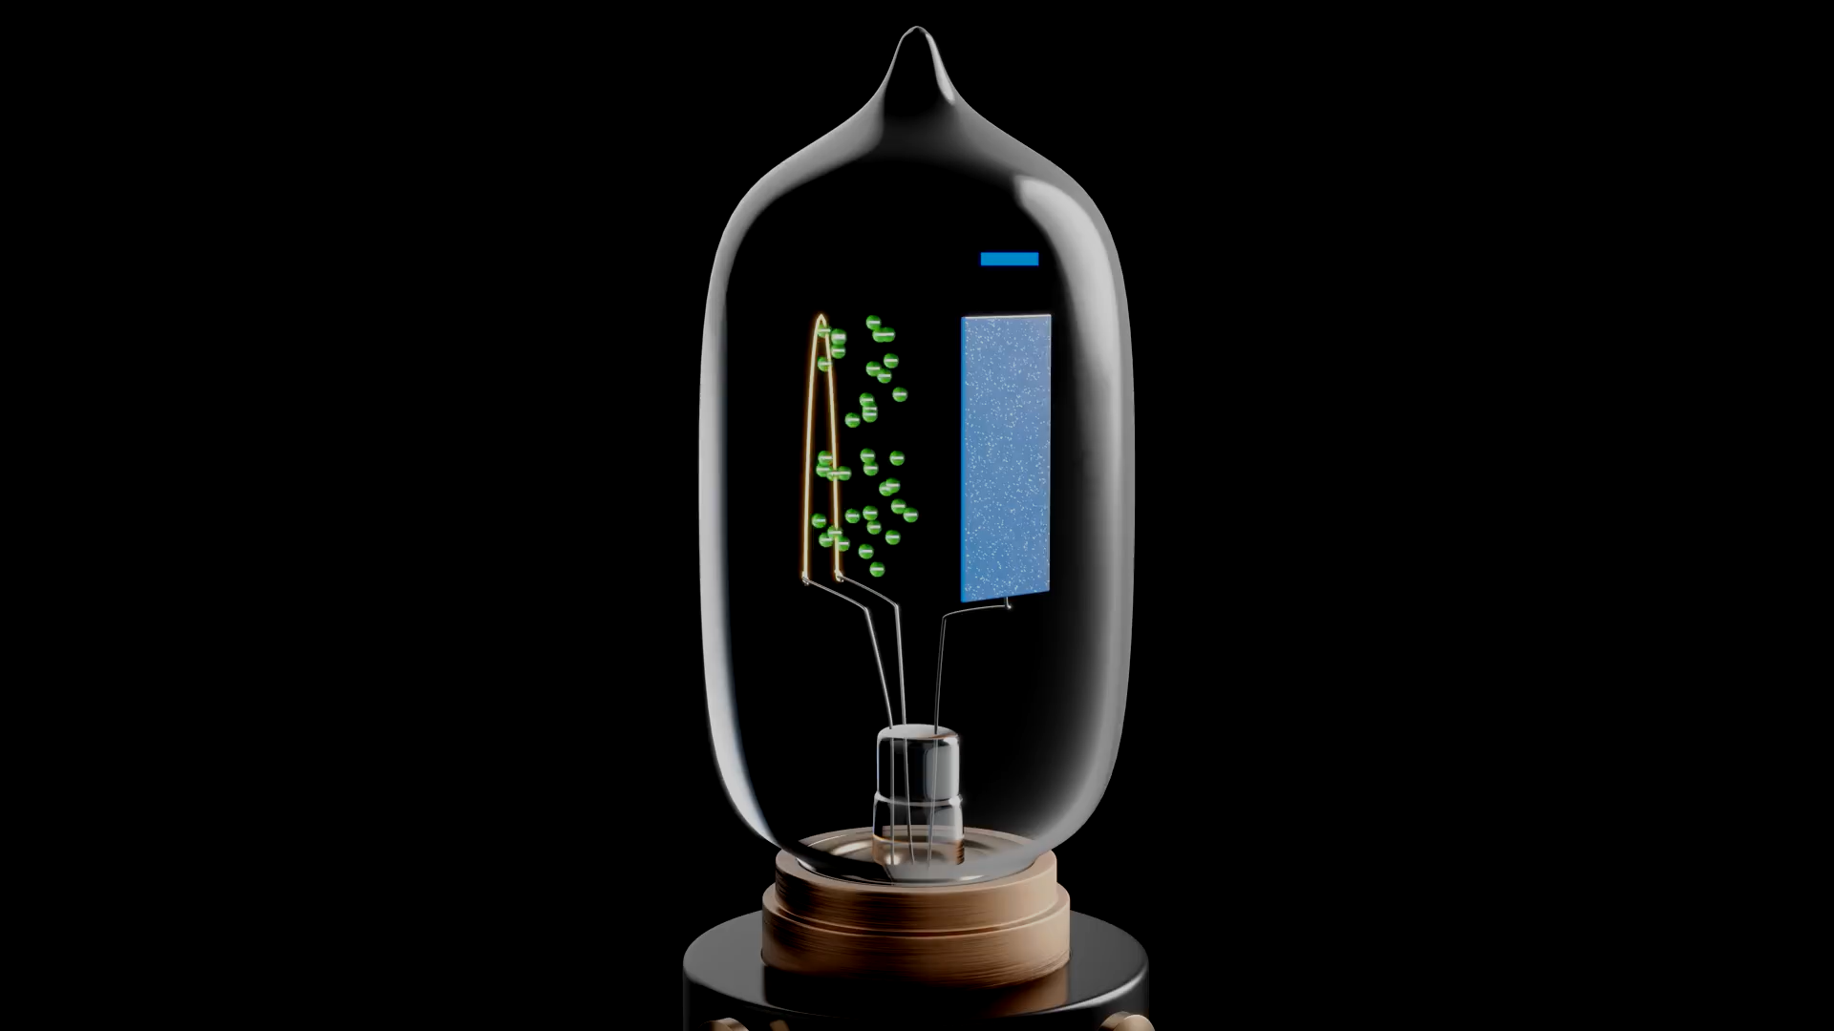

Slide 7
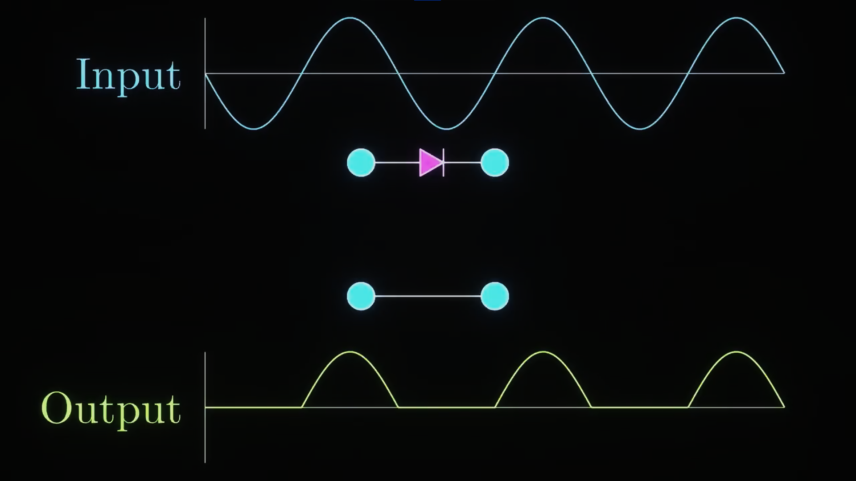
We can also use a diode like this one to convert AC into DC.

Slide 8
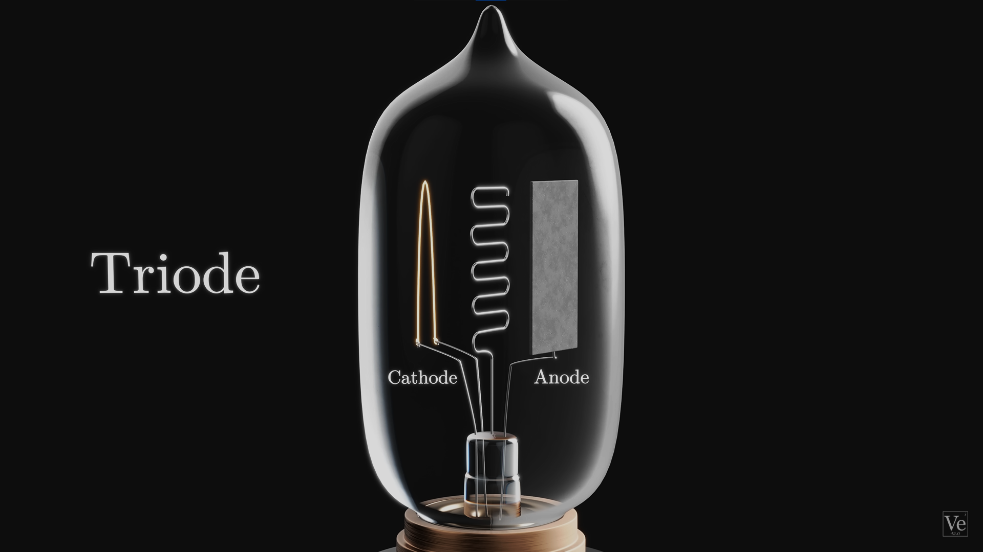
Then came the Triode
These consists of a grid between cathode and anode
This grid was able to control the Voltage. That helped to amplify signals.

Slide 9
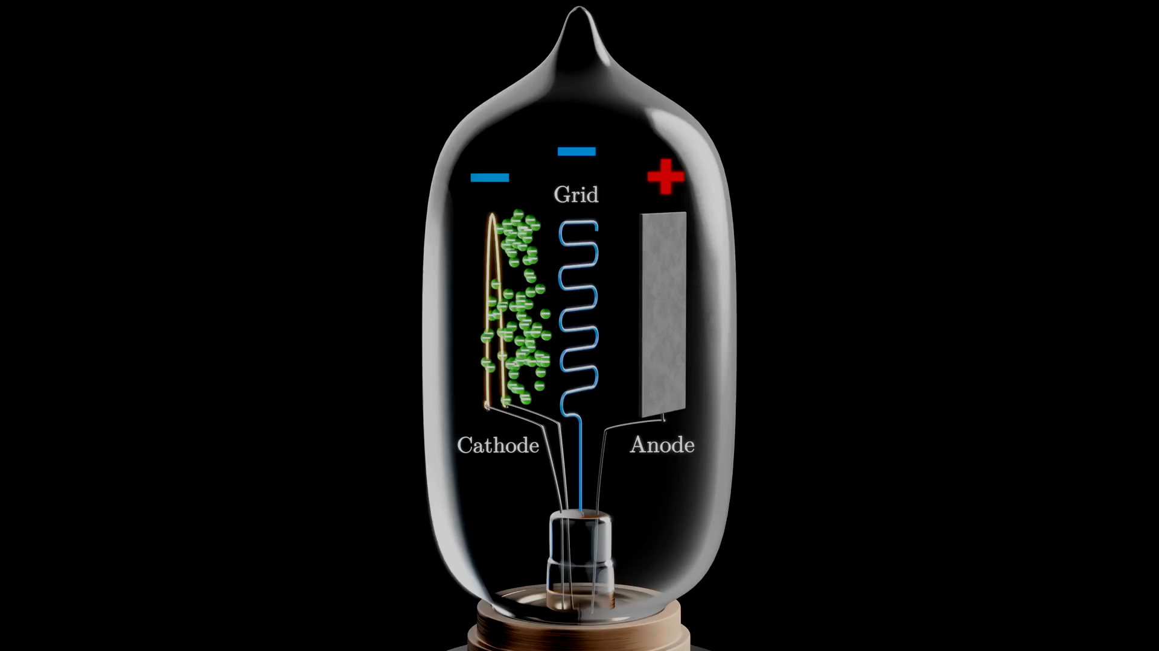

Slide 10
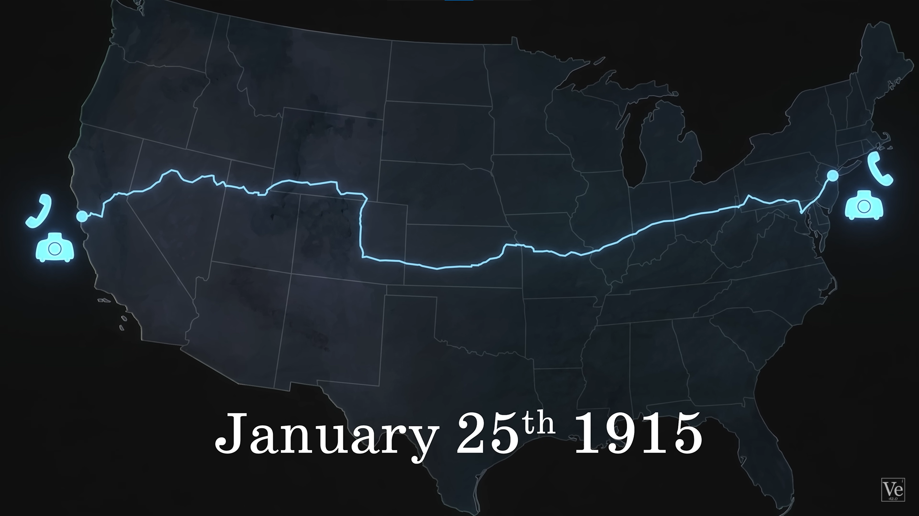
After amplification was discovered, it was applied to radio signals, enabling the first transcontinental phone call.
NEW YORK
SAN FRANSICO

Slide 11
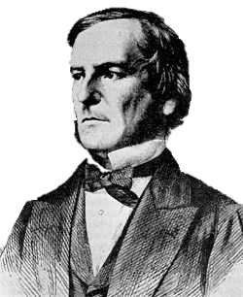
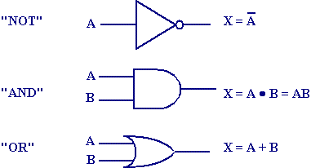
Father of Boolean Algebra
Boolean Algebra is the core of computer logic ,used in decision making , programming and in digital circuits
Binary Values:
1 (TRUE) 0 (FALSE)
Logical Operators:
AND (∧) OR (∨) NOT (¬)
His algebra is the basic to design of digital computer circuits
George Boole

Slide 12


Slide 13
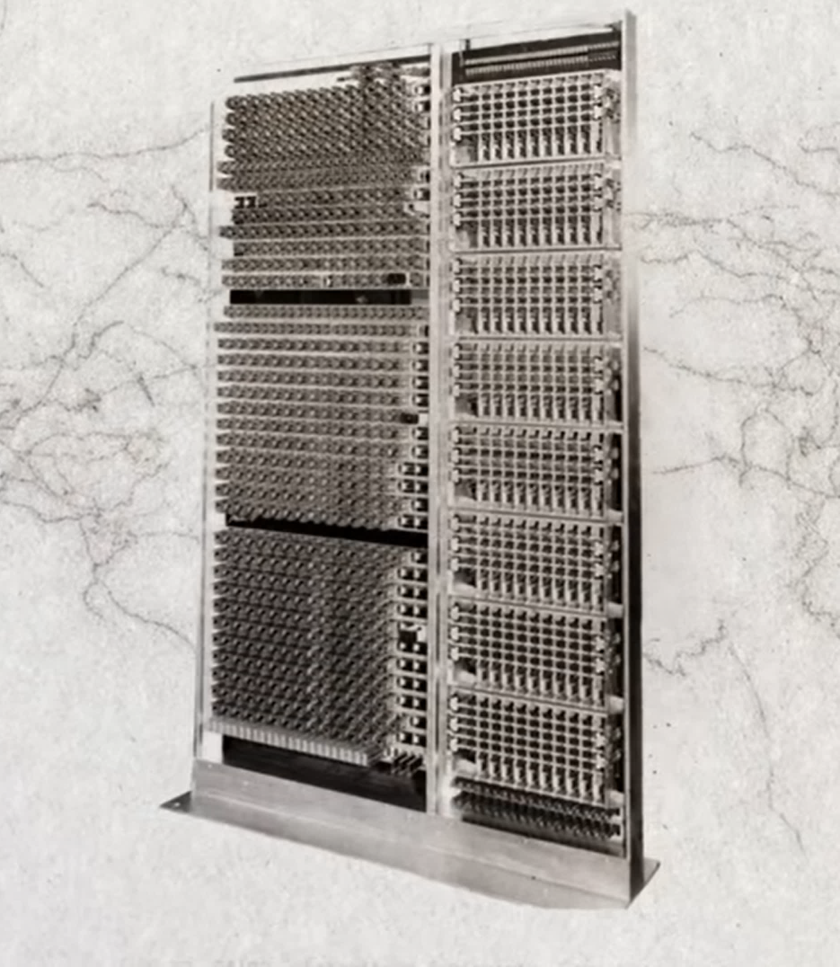
This made the first calculator computer
Modal 1
But the Problem was same , the Switches That ON and OFF physically…
This made the computers loud and Almost useless.

Slide 14
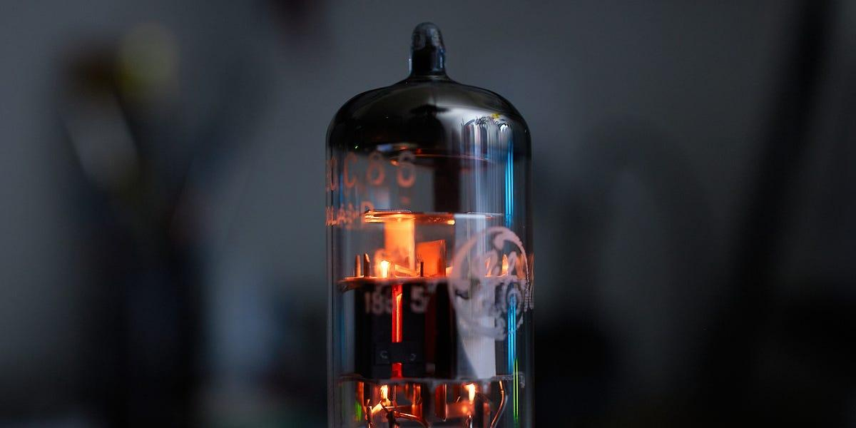
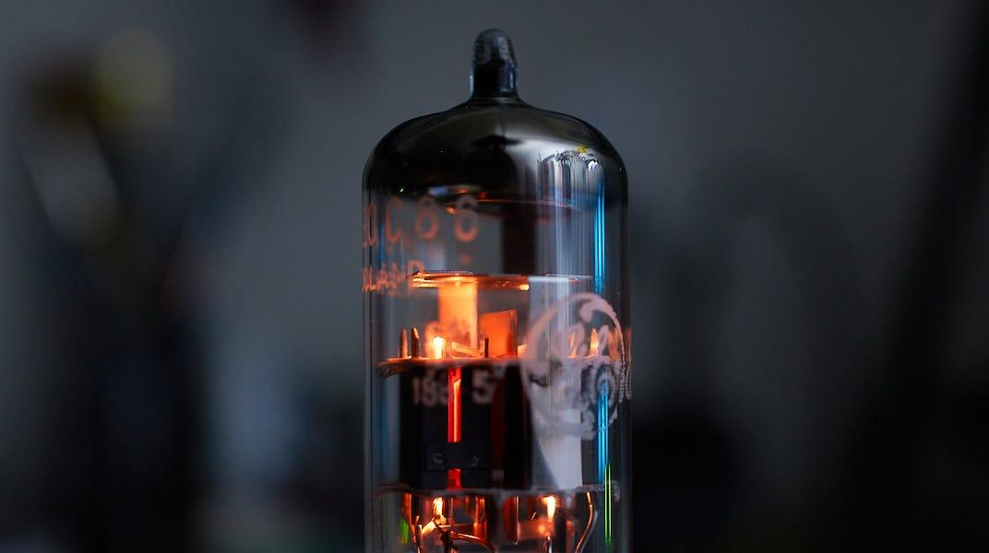
The vacuum tube allows the Flexibility that it can be controlled without any moving parts
So no physical ON and OFF switch
----------------
And you can switch between 0 and 1 immediately

Slide 15
IT COULD BE PROGRAMMED AND WAS ABLE TO PERFORM 500 OPERATIONS PER SECONDS
Then the FIRST PROGRAMMABLE COMPUTER - ENIAC was developed.
IT TOOK THE SPACE OF WHOLE ROOM , WEIGHED 30 TONS AND TOOK A LOT OF ENERGY TO RUN.

Slide 16
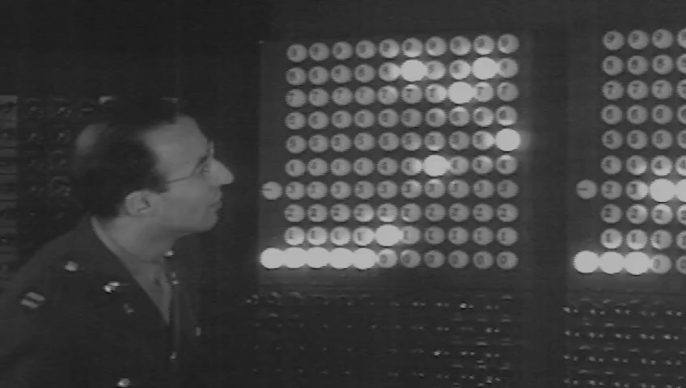

Slide 17
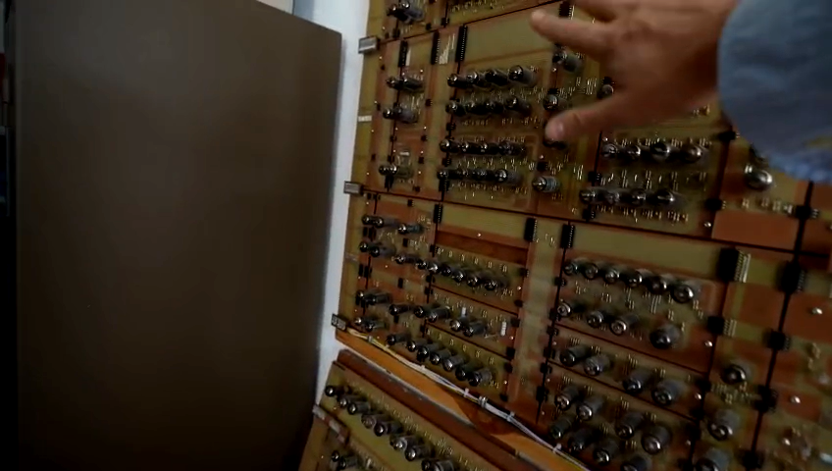
THIS IS HOW A ONE BIT VACCUM COMPUTER LOOKS LIKE …..

Slide 18

THIS IS HOW A ONE BIT VACCUM COMPUTER LOOKS LIKE …..

Slide 19
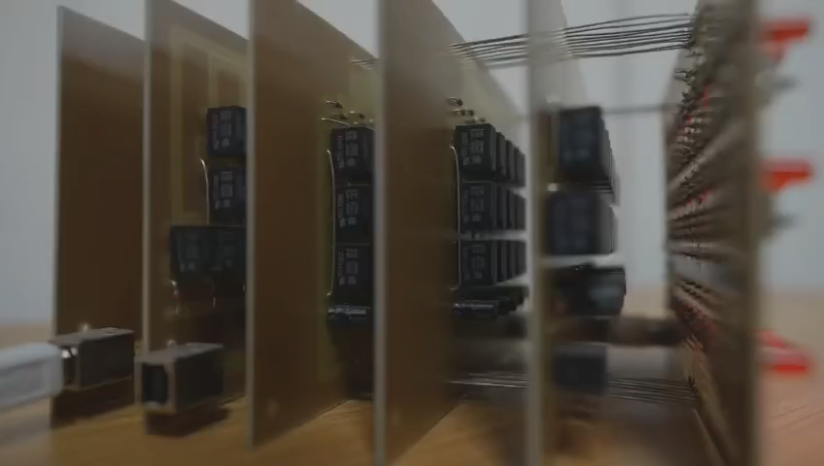

Slide 20
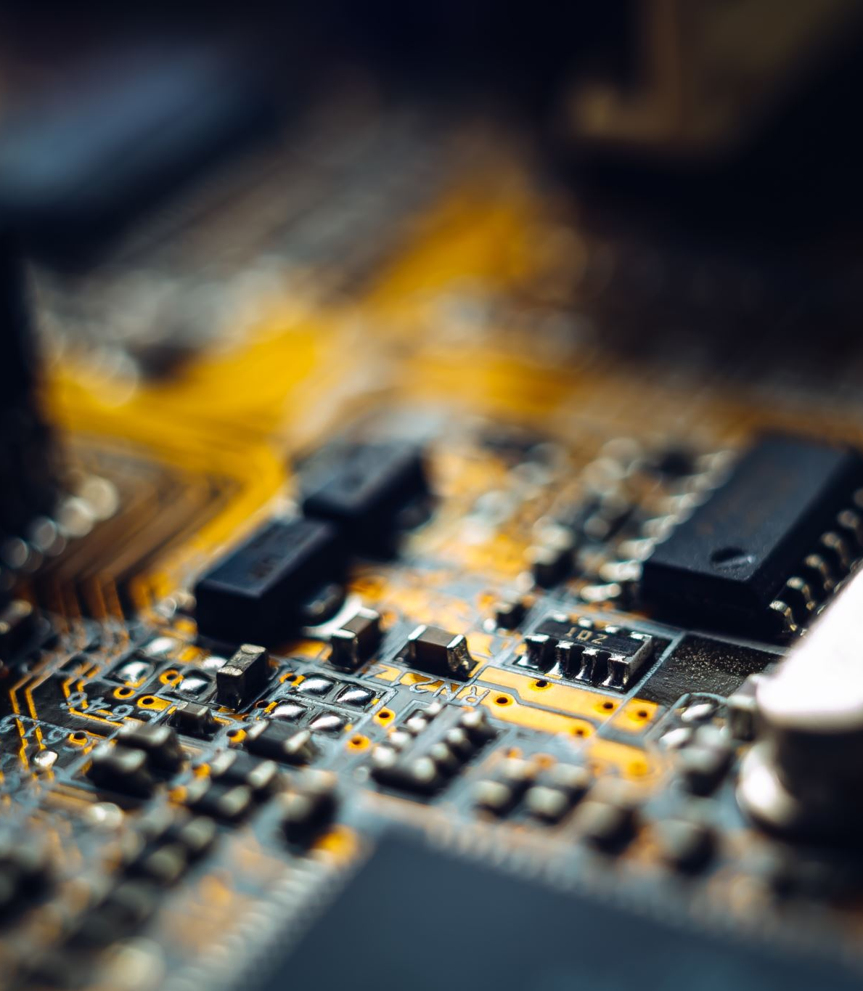
THE NEXT OF GENERATION COMPUTERS
Next generation of computers exist because someone discovered how to incorporate the same principles used in vacuum tubes or triodes into silicon chips.

Slide 21


Conclusion
Thermionic emission from light bulbs laid the groundwork for electronic control.
Vacuum tubes emerged as the first controllable electronic switches and signal amplifiers.
The invention of the triode enabled efficient signal amplification, transforming communication technologies.
Boolean logic introduced binary decision-making, forming the core of digital computation.
These advances led to ENIAC, the world’s first programmable electronic computer.
The transition to silicon-based transistors revolutionized computing, making it faster, smaller, and more powerful
EVERY TIME YOU USE A COMPUTER — REMEMBER, IT STARTED WITH A BULB.

Slide 22



